Slide 1
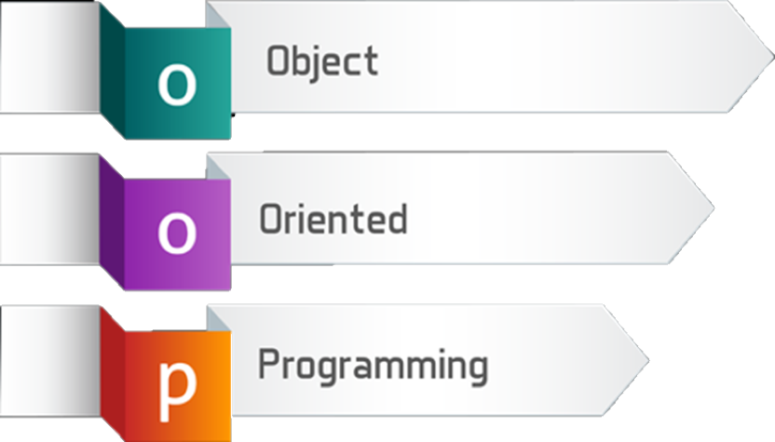
Defining Classes
SoftUni Team
Technical Trainers
Software University
https://about.softuni.bg/

Slide 2
Have a Question?
sli.do
#prgm-for-qa

Slide 3
Table of Contents
Revision: Classes and Objects
Fields and Properties
Methods
Constructors and Constructors Chaining
Enumerations
Static Classes
Namespaces

Slide 4

Revision: Defining Simple Classes

Slide 5
Defining Simple Classes
Class is a concrete implementation of an ADT
Classes provide structure for describing and creating objects
Keyword
Class name
class Animal
{
…
}
Class body
5

Slide 6
Class Members
Members are declared in the class and they have
certain accessibility
They can be:
Fields
Properties
Methods
class Animal
{
int legs;
string Name { get; }
void Walk() { … }
}
Field
Property
Method
6

Slide 7
Object Reference
Declaring a variable creates a reference in the stack
The new keyword allocates memory on the heap
Animal dog = new Animal();
Stack
Heap
obj
dog
(1540e19d)
name = null
legs = 0
7

Slide 8


Classes vs. Objects
Classes provide structure for describing and creating objects
An object is a single instance of a class
Animal is…
Animal
Animal (Class)
dog (Object)
8

Slide 9

Fields and Properties
Storing Data Inside a Class

Slide 10
Fields and Modifiers
Class fields have type and name
Access modifiers (public / private) define accessibility
Class modifier
public class Animal
{
private string name;
private int legs;
private Person owner;
public void Walk () { … }
}
Fields should always be private
Fields can be of any type
10

Slide 11
Properties
Used to create accessors and mutators (getters and setters)
public class Animal
{
private int legs;
public int Legs
{
public get { return this.legs; }
public set { this.legs = value; }
}
}
The field is hidden
The getter provides access to the field
The setter provides field change
11

Slide 12

Methods
Defining a Class Behaviour

Slide 13

Methods
Store executable code (an algorithm)
public class Animal
{
private int legs;
public int Walk() {
//implement behavior
}
}
13

Slide 14


Constructors
Object Initialization

Slide 15
Constructors
When a constructor is invoked, it creates an instance of its class and usually initializes its members
Classes in C# are instantiated with the keyword new
public class StartUp
{
static void Main()
{
Animal cat = new Animal();
}
}
public class Animal
{
public Animal() {}
}
15

Slide 16
Multiple Constructors
You can have multiple constructors in the same class
public class Animal
{
private int legs;
public Animal() { }
public Animal(int legs)
{
this.legs = legs;
}
}
Constructor without parameters
Constructor with parameters

Slide 17
Constructor Chaining
Constructors can call each other
public class Person {
private string name;
private int age;
public Person()
{
this.age = 18;
}
public Person(string name) : this() {
this.name = name;
}
}
Calls default constructor

Slide 18

Enumerations
Syntax and Usage

Slide 19
Enumerations
Represent a numeric value from a fixed set as a text
We can use them to pass arguments to methods without making code confusing
By default enums start at 0
Every next value is incremented by 1
enum Day { Mon, Tue, Wed, Thu, Fri, Sat, Sun }
GetDailySchedule(0)
GetDailySchedule(Day.Mon)
19

Slide 20




Enumerations (2)
We can customize enum values
enum Day {
Mon = 1,
Tue, // 2
Wed, // 3
Thu, // 4
Fri, // 5
Sat, // 6
Sun // 7
}
enum CoffeeSize
{
Small = 100,
Normal = 150,
Double = 300
}

Slide 21

Static Classes
Static Class Members

Slide 22
Static Class
A static class is declared by the static keyword
It cannot be instantiated
You cannot declare variables from its type
You access its members by using the its name
double roundedNumber = Math.Round(num);
int absoluteValue = Math.Abs(num);
int pi = Math.PI;
22

Slide 23
Static Members
Both static and non-static classes can contain static members:
Methods, fields, properties, etc.
A static member is callable on a class even when no instance of the class has been created
Аccessed by the class' name, not the instance name
Only one copy of a static member exists, regardless of how many instances of the class are created
23

Slide 24
Static Members
Static methods can be overloaded but not overridden
A const field is essentially static in its behavior and it belongs to the type, not the instance
Static members are initialized before the static member is accessed for the first time and before the static constructor
Bus.Drive();
int wheels = Human.NumberOfWheels;

Slide 25
Example: Static Members
public class Engine
{
public static void Run() {
Console.WriteLine("This is a static method"); }
}
public static void Main() {
Engine.Run();
}
// Output: This is a static method

Slide 26

Namespaces
Definition and Usage

Slide 27
Namespaces
Used to organize classes
The using keyword allows us not to write their names
Declaring your own namespaces can help you control the scope of class and method names
System.Console.WriteLine("Hello world!");
List<int> list = new
System.Collections.Generic.List<int>();
27

Slide 28

Summary
…
…
…
Classes define structure for objects
Objects are instances of a class
Classes define fields, methods, constructors and other members
Constructors:
Invoked when creating new instances
Initialize the object's state

Slide 29









Questions?

Slide 30













SoftUni Diamond Partners

Slide 31
Trainings @ Software University (SoftUni)
Software University – High-Quality Education, Profession and Job for Software Developers
softuni.bg, about.softuni.bg
Software University Foundation
softuni.foundation
Software University @ Facebook
facebook.com/SoftwareUniversity
Software University Forums
forum.softuni.bg
31
Notes:
31

Slide 32

License
This course (slides, examples, demos, exercises, homework, documents, videos and other assets) is copyrighted content
Unauthorized copy, reproduction or use is illegal
© SoftUni – https://about.softuni.bg/
© Software University – https://softuni.bg
Notes:
32

